Slide 1
Predicting Credit Defaults
A prototype model using advanced analytics

Slide 2
Outline
An overview of the data: Historical defaults
Credit default model
2.1 Model setup
2.2 Model training
2.3 Factors driving default
Results on test data
Comparing machine-learning model with a sub-grade model
Appendix

Slide 3
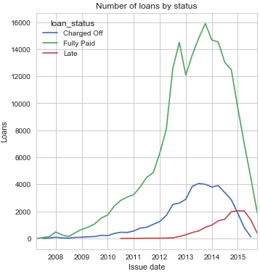
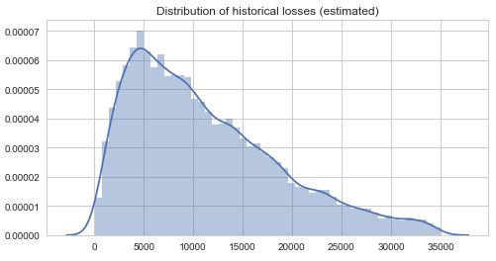
1. An overview of the data: Historical defaults
The historical default rate (of terminated loans) has been around 18%
Using median recovery rate this amount to approximately 0.5bn in losses

Slide 4
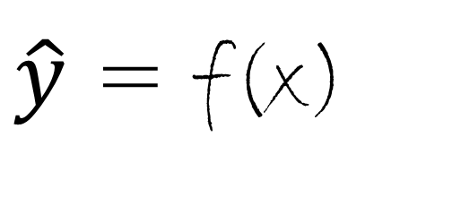
2.1 Credit default modeling: A supervised learning problem
Training data
Test data
trained model
trained model
y = f(x)
$\hat{y}$ = f(x)
default info from training data
features
(data on borrower, loan)
model prediction
new unseen data
(data on borrower, loan)

Slide 5
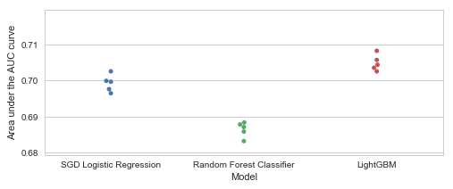
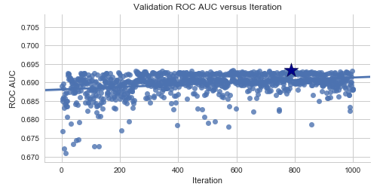


2.2 Credit default modeling: Finding the ‘f()’
Step 1: GridSearchCV with 3 different algorithms
Cross-validation = 5-kfold
iteration 1
Test
train
train
train
train
iteration 2
train
Test
train
train
train
iteration 3
train
train
Test
train
train
iteration 4
train
train
train
Test
train
iteration 5
train
train
train
train
Test
Step 2: Bayesian hyperparameter optimization
Machine learning process
model hyperparameters (settings)
Optimal hyperparameters
optimal
model parameters (weights)
Model fitting

Slide 6
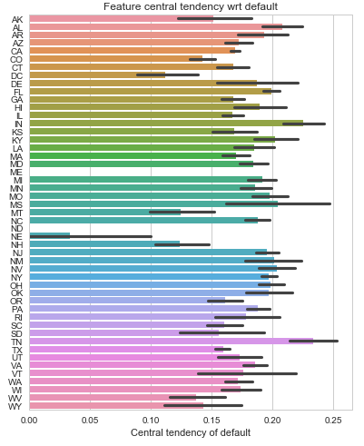
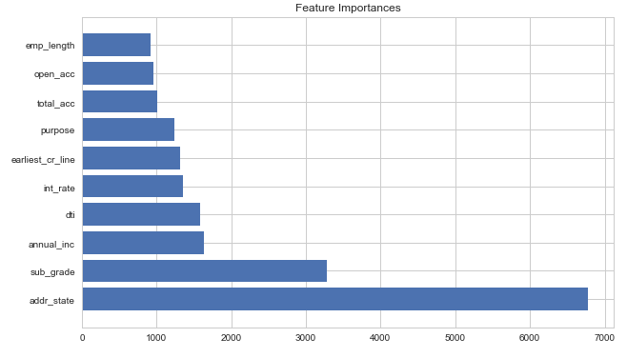
2.3 Credit default modeling: Factors driving default
Feature importances
Default by US state (‘addr_state’)

Slide 7
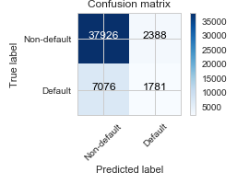
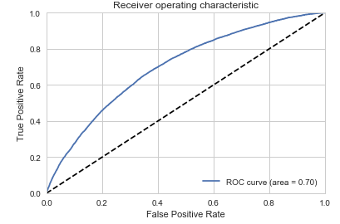
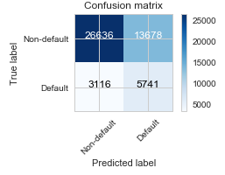
3. Results on test data – threshold to set the trade-off between rightly predicting defaults vs. wrongly predicting non-defaults
Threshold @ 0.70
Threshold @ 0.50
TPR = 20%
FPR = 6%
TPR = 65%
FPR = 34%

Slide 8
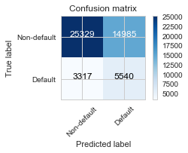
4. Comparing machine learning model with a model based on sub-grades shows that advanced analytics adds business value
Machine learning model with threshold @ 0.50
Sub-grades model with threshold @ 0.50
TPR = 65%
FPR = 34%
TPR = 62%
FPR = 37%
The sub-grades model has 201 more false negatives than the ML model (losses from 201 loans that could be avoided)
But equally important, the sub-grade model would wrongly label 1307 more non-defaulters – i.e. foregoing business opportunity from 1307 customers

Slide 9
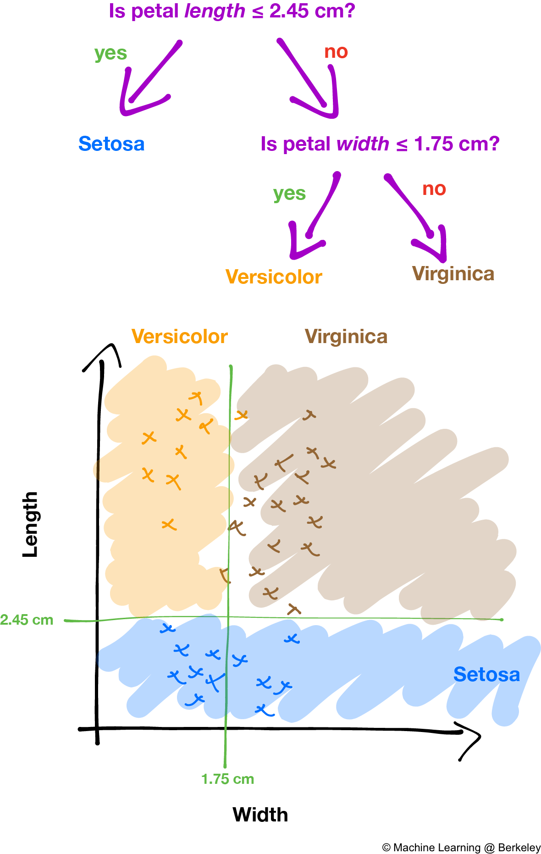
Appendix I: A quick review of decision trees
Starts at root node (one feature) and finds the best split to max e.g. gini impurity
‘Builds the tree’ by progressing through each feature, until certain hyperparameters are reached (max depth, minimum samples in leaves)
Pros: easy to interpret and great as building stone in ensembles
Cons: overfits rather easily, and requires data to be orthogonally divisible

Slide 10
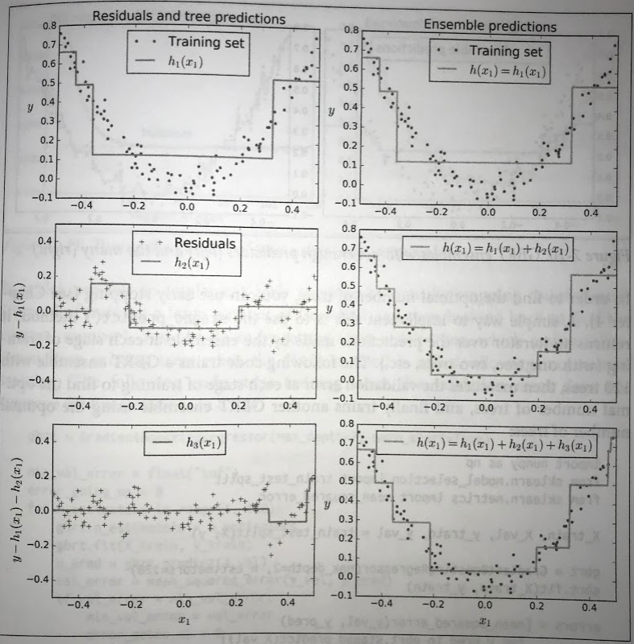
Appendix II: (Stochastic) Gradient Boosting
Boosting: ensemble combining several weak learners into a strong learner
Train learners sequentially
Gradient boosting: train next learner on residuals of former learner
Learning rate (or shrinkage factor) to decide how much each weak learner will contribute to the final model
Optimal number of trees can be found using early stopping decided by when the validation score has stopped improving
To decorrelate the learners, one can do subsampling of the training data – a technique called Stochastic Gradient Boosting

